Slide 1

Social media mining Final Project
Title : paper citation network Graph classification
組別 : 第三組
系級 : 資工所碩一
學號 : 110526001
姓名 : 鄭凱元

Slide 2
01
Explore
02
Previous Progress
Catalog
03
Dataset
04
Experiment Method
05
Result
06
Discussion

Slide 3

Explore
Previous Progress
Dataset
Experiment Method
Result
Discussion
Explore
1
Motivation: Which journal does the paper belong to?
2
BERT limitation on the paper classification
BERT + GCL performance
3
Discussion&Future improvement
4

Slide 4
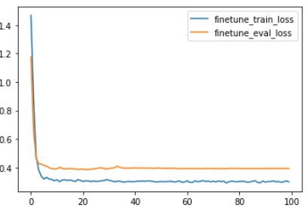
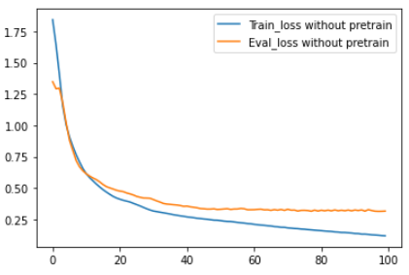
Explore
Previous Progress
Dataset
Experiment Method
Result
Discussion
Previous Progress
BERT
Accuracy: 0.815 (5 class)
5 journals:
Nature Machine Intelligence
Light: science & applications
Nature Computational Science
Scientific Data
Nature Biomedical Engineering
BERT+GCL
Accuracy: 0.809 (5 class)
4

Slide 5

Explore
Previous Progress
Dataset
Experiment Method
Result
Discussion
Dataset
Many Science, Medicine, Genetics and Biology papers are in “NATURE journal”.
In the platform, each paper has its own category.
Journal of Exposure Science & Environmental Epidemiology
Nature Medicine
Nature Energy
Nature Neuroscience
NPG Asia Materials
Nature Microbiology
Nature Geoscience
5
Notes:
Nature Medicine: 收錄生物醫學領域的論文，包括基礎研究和早期臨床研究的研究文章、綜述、研究新聞及評論。文章議題包括癌症、心血管疾病、基因治療、免疫學、免疫疫苗和神經科學。
Nature Microbiology:涵蓋了微生物研究的方面，包括進化、生理學和細胞生物學；他們彼此之間、與宿主之間，或與環境之間的相互作用；以及他們的社會學意義。
Nature Neuroscience: 發表分子、細胞、系統和認知神經科學以及心理物理學，計算模型和神經系統疾病方面的文章。
Nature Energy: 能源領域
NPG Asia Materials: 發表來自物理和化學科學、生物技術和納米技術的文章
Nature Geoscience: 在將地球科學中各個領域的頂級研究與相關領域的相關工作結合在一起。
Journal of Exposure Science & Environmental Epidemiology: 專注於為各種環境和公共衛生學科的專業人員提供接觸科學。

Slide 6
Explore
Previous Progress
Dataset
Experiment Method
Result
Discussion
Dataset column
Subject (Label)
Date
Author
Title
url
Reference
Abstract
Name | Graph number | Avg. Node | Avg. Degree
NCI1 | 4110 | 29.8 | 1.08
PROTIENS | 1113 | 39.06 | 1.86
My_data | 5312 | 17.68 | 2.85
Input Data
(Concat )
Fine-tune Data (Label Rate 10%)
Training data : 531 (10% )
Evaluation data : 4781 (90% )
Fine-tune Data (Label Rate 1%)
Training data : 53 (1% )
Evaluation data : 5259 (99% )
6

Slide 7
Explore
Previous Progress
Dataset
Experiment Method
Result
Discussion
Select embedding methods
Some proper nouns and abbreviations appear in the dataset, making unseen word error for glove embedding.
Using BERT model, but will cause the problem of out of memory.
Finally, Use Tiny BERT for the next step embedding.
7

Slide 8
Explore
Previous Progress
Dataset
Experiment Method
Result
Discussion
Tiny BERT finetune architecture
Authors
Title
Date
Tiny
BERT
Classifier
feedforward +
softmax
One of the journals

Slide 9
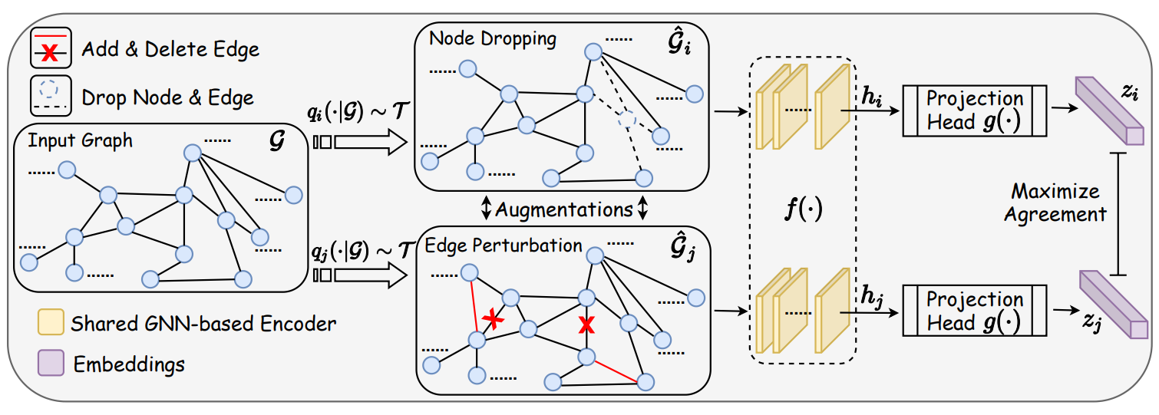
Explore
Previous Progress
Dataset
Experiment Method
Result
Discussion
BERT + GCL Pretraining
Node: Authors/Title/Date
Tiny BERT
GraphCL
Contrastive Loss
GraphCL architecture
Notes:
https://zhuanlan.zhihu.com/p/66589334
基於鄰域聚合的GNN可以拆分為以下三個模塊：
1.Aggregate：聚合一階鄰域特徵。
2.Combine：將鄰居聚合的特徵與當前節點特徵合併， 以更新當前節點特徵。
3. Readout（可選）：如果是對graph分類，需要將graph中所有節點特徵轉變成graph特徵。(GCL用add)
https://github.com/Shen-Lab/GraphCL/blob/e9e598d478d4a4bff94a3e95a078569c028f1d88/semisupervised_MNIST_CIFAR10/pre-training/layers/mlp_readout_layer.py
https://github.com/Shen-Lab/GraphCL/blob/e9e598d478d4a4bff94a3e95a078569c028f1d88/semisupervised_MNIST_CIFAR10/pre-training/main_superpixels_contrastive.py (args.L是指GCN的層數)

Slide 10
Explore
Previous Progress
Dataset
Experiment Method
Result
Discussion
BERT + GCL Finetune
Node: Authors/Title/Date
Tiny BERT
GraphConv
MLP
BCE Loss
GraphCL architecture
Notes:
https://github.com/Shen-Lab/GraphCL/blob/e9e598d478d4a4bff94a3e95a078569c028f1d88/semisupervised_MNIST_CIFAR10/finetuning/main_superpixels_graph_classification.py
https://github.com/Shen-Lab/GraphCL/blob/e9e598d478d4a4bff94a3e95a078569c028f1d88/semisupervised_MNIST_CIFAR10/finetuning/nets/superpixels_graph_classification/gcn_net.py
到底有沒有freeze GCN (怎麼沒看到freeze)

Slide 11
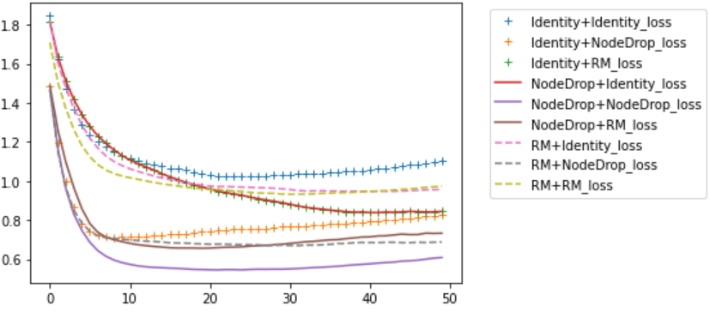
Explore
Previous Progress
Dataset
Experiment Method
Result
Discussion
Choose Pretraining
mode
Pretraining mode | Finetune Accuracy
NodeDrop+NodeDrop | 0.837
NodeDrop+RW | 0.831
RW+NodeDrop | 0.841
紅色代表: 使用這個augmentation graph的GCN做finetune

Slide 12
Explore
Previous Progress
Dataset
Experiment Method
Result
Discussion
Difference
(GCN + BatchNorm) *3 +
(Linear + relu) *1 +
Linear
(GCN + BatchNorm) *2 +
(Linear + relu) *1 +
Linear
My Model
GraphCL
Others: GCL not freeze (GCN + BatchNorm) in original paper
Model (Label Rate) | NCI1 | Proteins
GraphCL (1%) | 0.607 | 0.627
GraphCL (10%) | 0.742 | 0.714
My Model (1%) | 0.593 | 0.584
My Model(10%) | 0.676 | 0.673
12
Notes:
https://github.com/Shen-Lab/GraphCL/blob/master/semisupervised_TU/pre-training/res_gcn.py
(GCN + BatchNorm) *3 +
(Linear + relu) *1 +
Linear
都是用add_pool

Slide 13
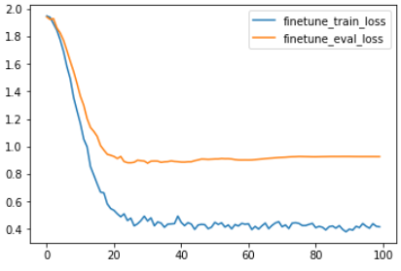
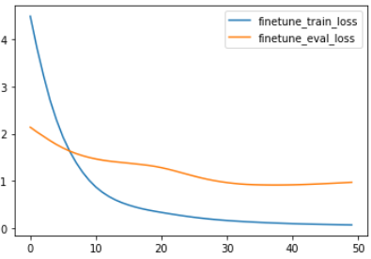
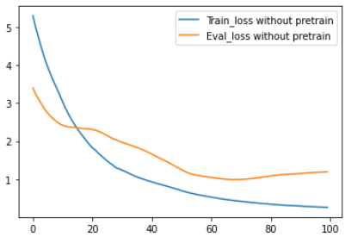
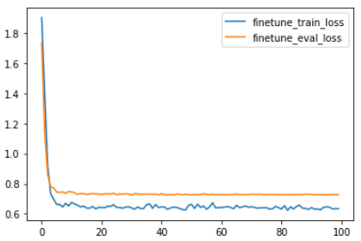
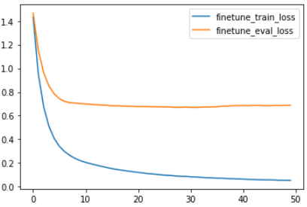
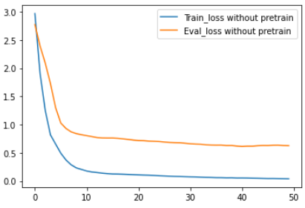
BERT + GCL
(Pretraining : RW + NodeDrop)
BERT + GCL
(without Pretraining)
BERT
Label : 0.01%
Accuracy:0.690
Accuracy:0.626
Accuracy:0.628
Label : 0.1%
Accuracy:0.705
Accuracy:0.841
Accuracy:0.811

Slide 14
Explore
Previous Progress
Dataset
Experiment Method
Result
Discussion
Discussion
GNN-based model is suitable for similar journals prediction
Label Rate | Tiny BERT (date/title/author) | BERT (abstract) | GraphCL (one hot) | Bert + GCL | Bert + GCL (without Pretrain)
1% | 0.690 | 0.663 | 0.300 | 0.626 | 0.628
10% | 0.705 | 0.788 | 0.403 | 0.841 | 0.811

Slide 15
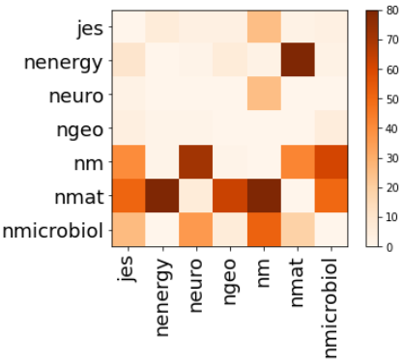
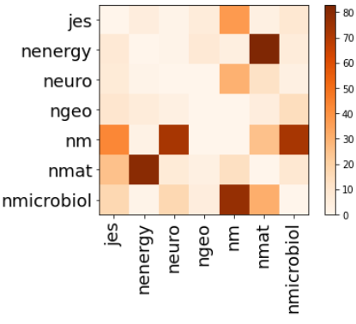
Explore
Previous Progress
Dataset
Experiment Method
Result
Discussion
Error Prediction
Without pretrain
pretrain
Amount of Data
jes: 900
nenergy: 570
neuro: 747
ngeo: 823
nm: 652
nmat: 777
nmicrobiol: 843
Prediction
Actual
Notes:
(jes) Journal of Exposure Science & Environmental Epidemiology
(nenergy) Nature Energy
(neuro) Nature Neuroscience
(ngeo) Nature Geoscience
(nm) Nature Medicine
(nmat) NPG Asia Materials
(nmicrobiol) Nature Microbiology

Slide 16
Explore
Previous Progress
Dataset
Experiment Method
Result
Discussion
Prediction error
Prediction: nature energy / Actual: nature material
1. benduhn, j. et al. intrinsic non - radiative voltage losses in fullerene - based organic solar cells. nat. energy 2, 17053 ( 2017 ).
Prediction: nature medicine / Actual: nature neuroscience
2. chen, j. a., penagarikano, o., belgard, t. g., swarup, v. & geschwind, d. h. the emerging picture of autism spectrum disorder : genetics and pathology. ( 2015 ).
Prediction: nature medicine / Actual: nature microbiology
3. li, y. et al. exogenous stimuli maintain intraepithelial lymphocytes via aryl hydrocarbon receptor activation. ( 2011 ).
Prediction: nature material / Actual: nature energy
4. yu, t., kim, d. y., zhang, h. & xia, y. n. platinum concave nanocubes with high - index facets and their enhanced activity for oxygen reduction reaction. ( 2011 ).
Notes:
1.基於富勒烯的有機太陽能電池的固有非輻射電壓損失。
2.自閉症譜系障礙的新畫面：遺傳學和病理學。
3.外源性刺激通過芳烴受體激活維持上皮內淋巴細胞。
4.具有高折射率晶面的鉑凹納米立方體及其對氧還原反應的增強活性。

Slide 17
References
Shu, F., Julien, C. A., Zhang, L., Qiu, J., Zhang, J., & Larivière, V. (2019). Comparing journal and paper level classifications of science. Journal of Informetrics, 13(1), 202-225.
You, Y., Chen, T., Sui, Y., Chen, T., Wang, Z., & Shen, Y. (2020). Graph contrastive learning with augmentations. Advances in Neural Information Processing Systems, 33, 5812-5823.
You, Y., Chen, T., Shen, Y., & Wang, Z. (2021, July). Graph contrastive learning automated. In International Conference on Machine Learning (pp. 12121-12132). PMLR.
Chen, T., Kornblith, S., Swersky, K., Norouzi, M., & Hinton, G. E. (2020). Big self-supervised models are strong semi-supervised learners. Advances in neural information processing systems, 33, 22243-22255.
Notes:
SimCLRv2

